Slide 1
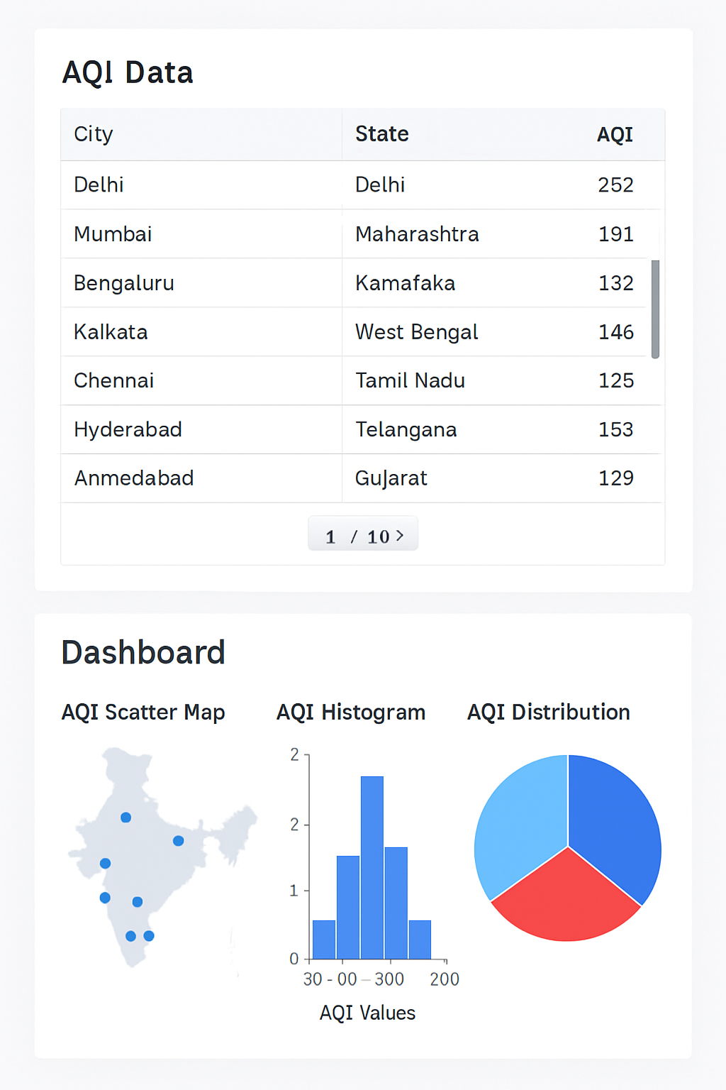
NAME: ARPAN CHATTERJEE
Roll: 2312RES162
Adm. No: IITP000646
4th SEM BSc. CSDA
GUVI + HCL SUMMER INDUSTRY INTERNSHIP
Email-id: arpan_2312res162@iitp.ac.in
GitHub Link: https://github.com/ArpanC03/GuviProject1DataScience

Slide 2
DATA SCIENCE INTERN
Problem Statement 5:
AQI Mapping of Indian Cities
Mapping of AQI readings using geospatial visualizations.
Choropleth map by AQI
Tooltip: City name + AQI
AQI filter: Good, Moderate, Poor
Air pollution in Indian cities is a major environmental and health concern, but city-level AQI data is complex, scattered, and difficult for citizens or policymakers to interpret quickly.
Our goal: Build an interactive dashboard that streamlines exploration, visualization, and analysis of real AQI data for all major Indian cities, to empower evidence-driven action and awareness.

Slide 3
1. Data Collection:
- Gather raw AQI data (CSV/online sources).
2. Data Preparation in Google Colab:
- Cleanse, validate, and categorize AQI values programmatically (Python).
3. Visualization & Dashboard:- Instantly explore data using interactive dashboards:
- Google Colab (Python/Plotly visuals)
- Power BI (interactive mapping, charts, slicers)
- Streamlit (web-based app/dashboard)
4. Share & Reproduce:
- All files and code available openly via GitHub.
DATA PIPELINE AND WORKFLOW

Slide 4
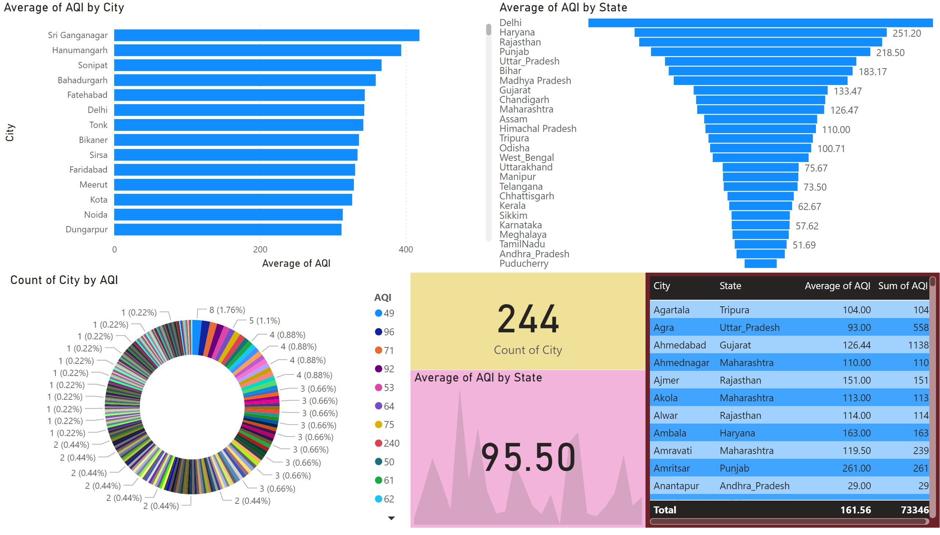
Page 1
Notes:
barChart
No alt text provided
kpi
No alt text provided
card
No alt text provided
funnel
No alt text provided
tableEx
No alt text provided
donutChart
No alt text provided

Slide 5
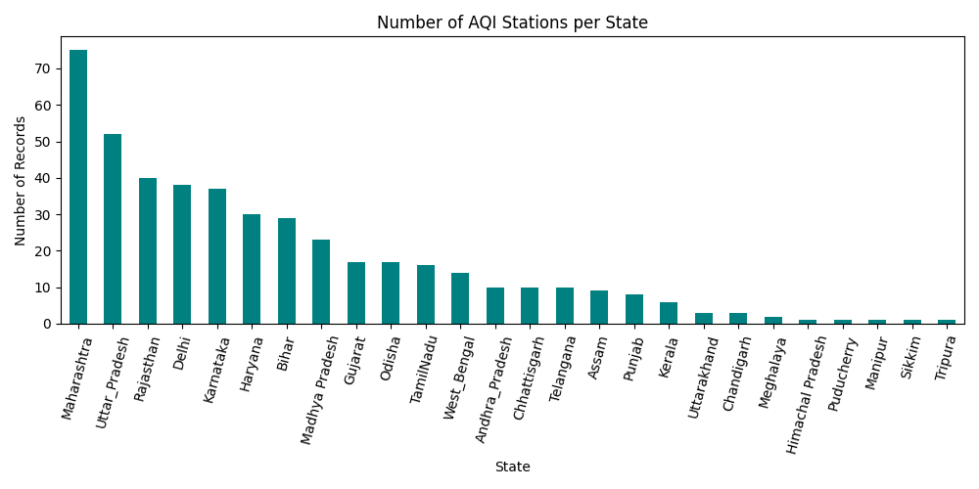
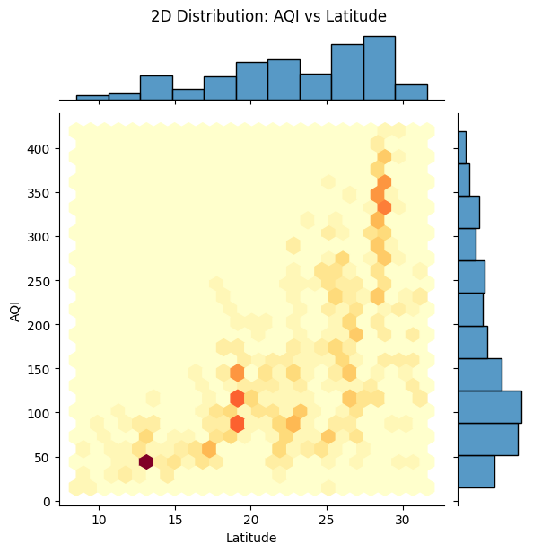
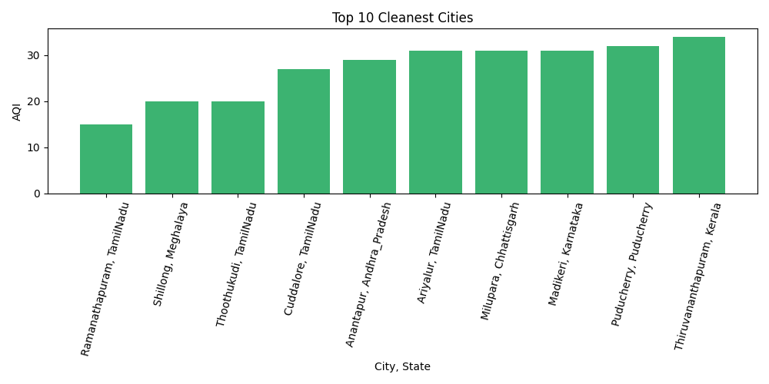

Slide 6
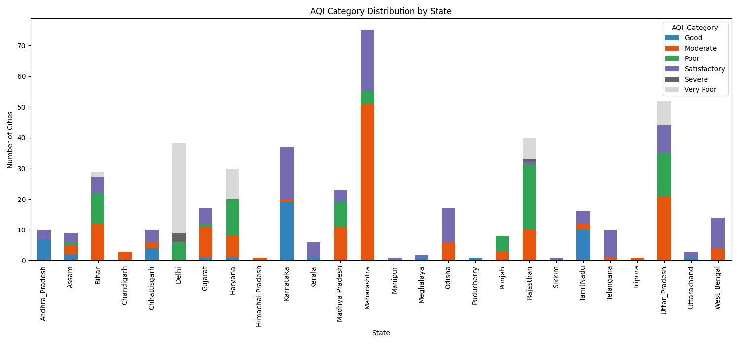
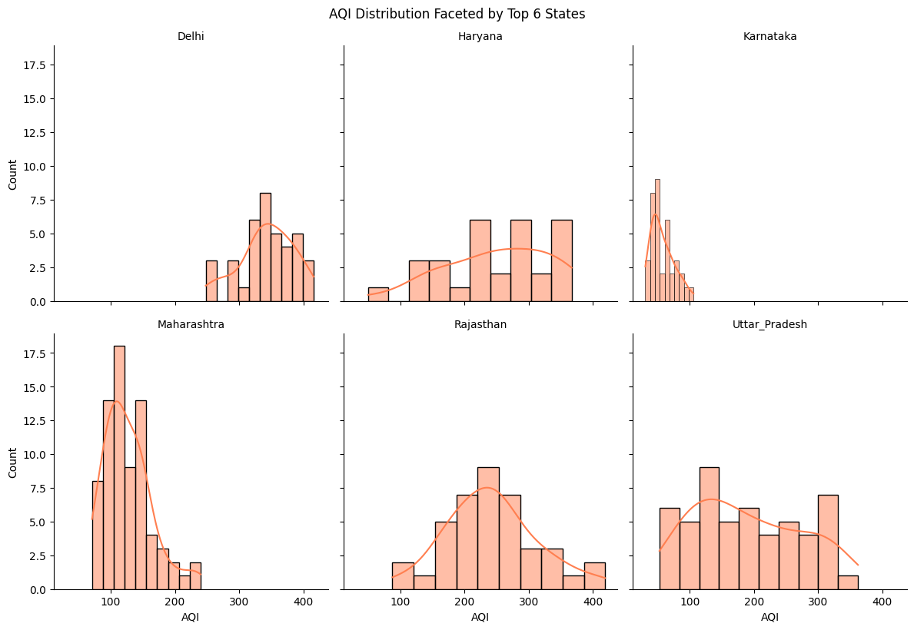
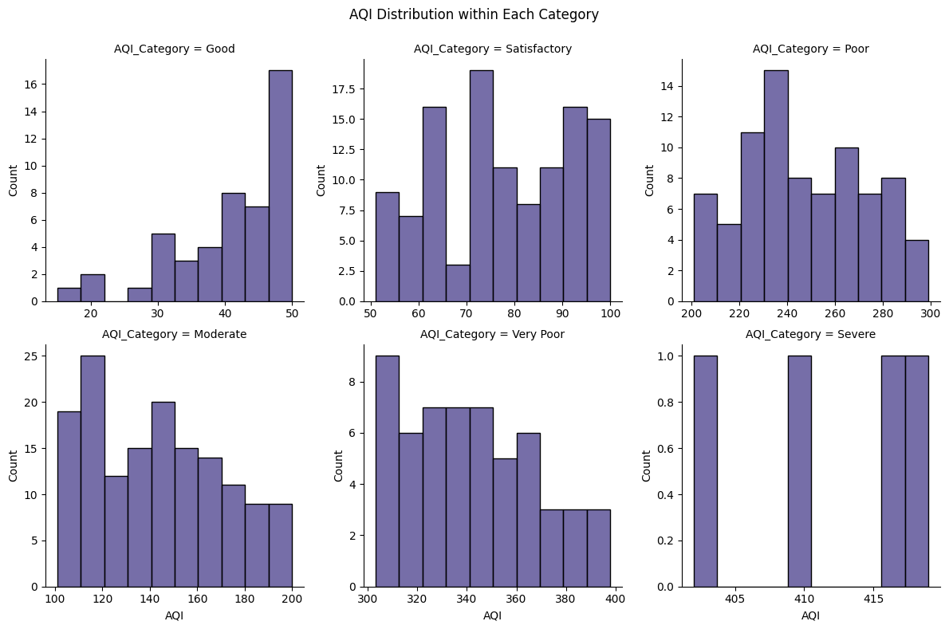
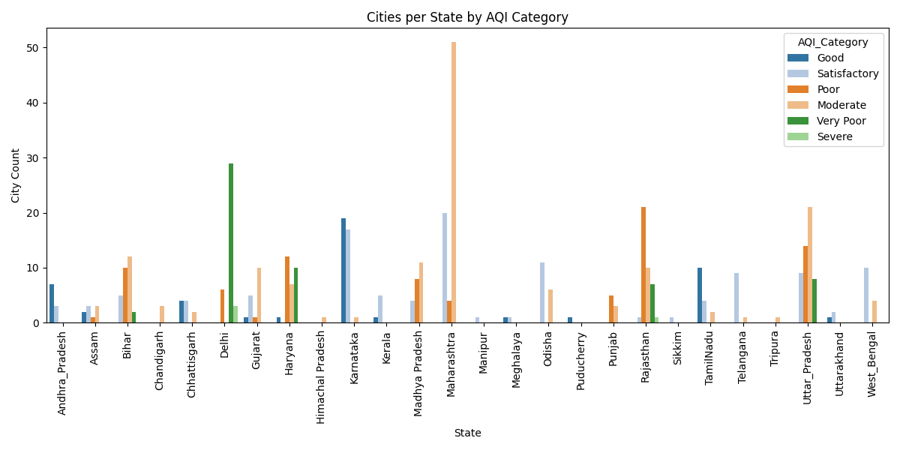

Slide 7
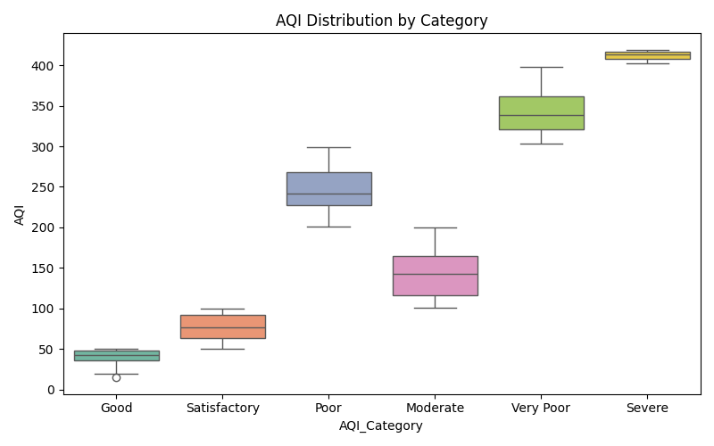
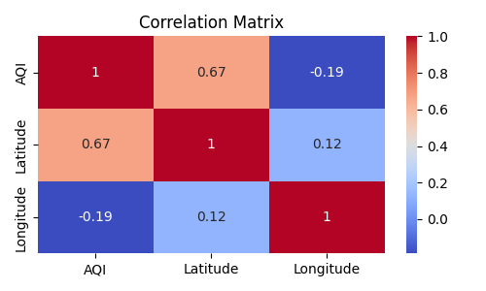
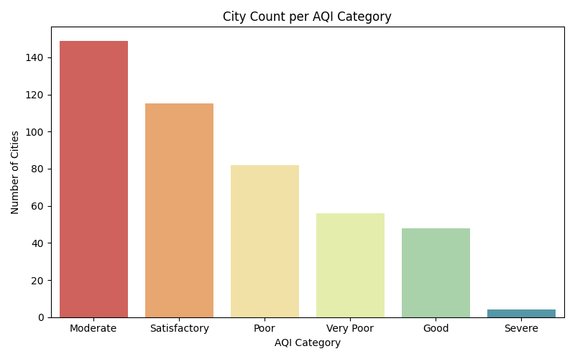
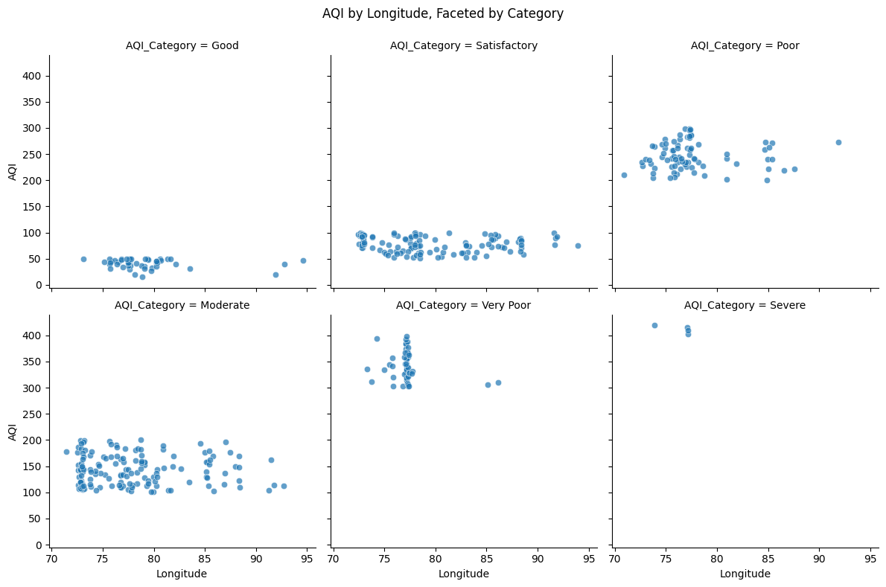
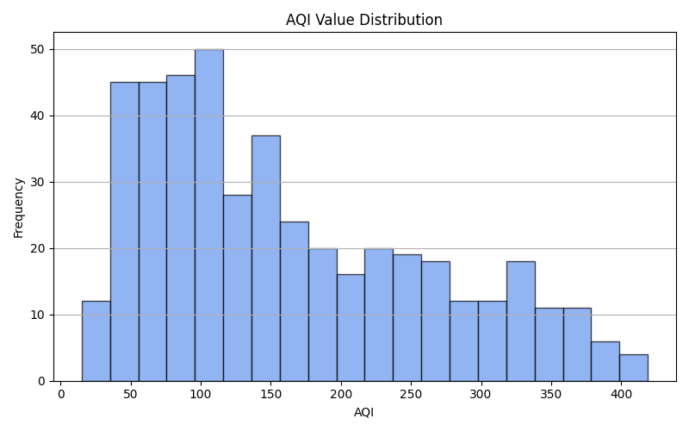

Slide 8
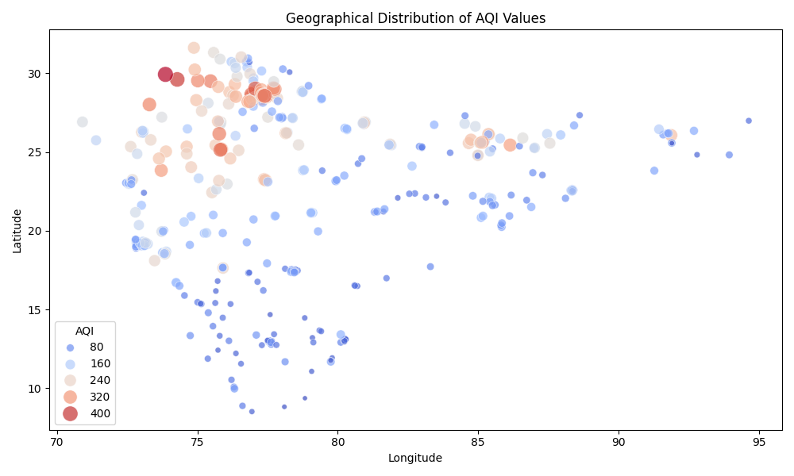
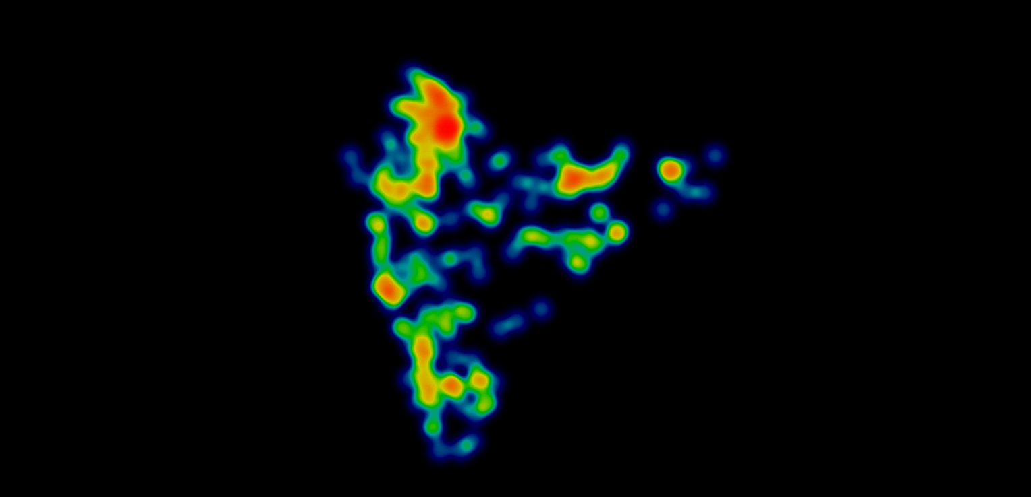
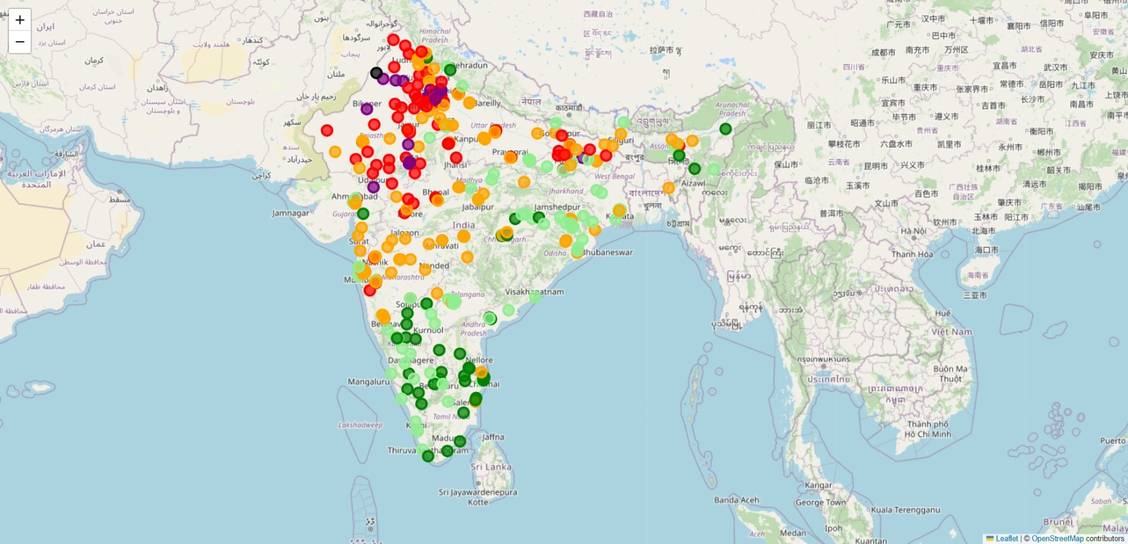
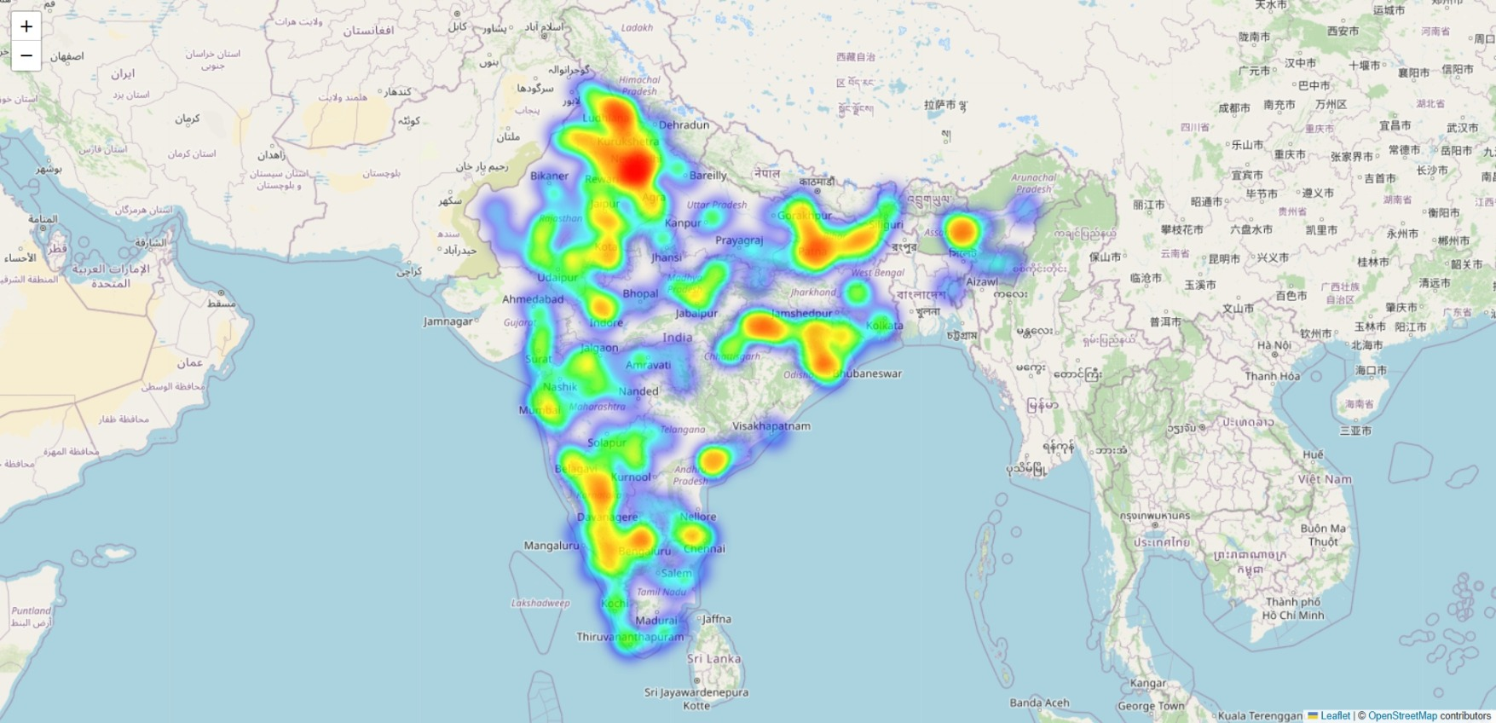

Slide 9
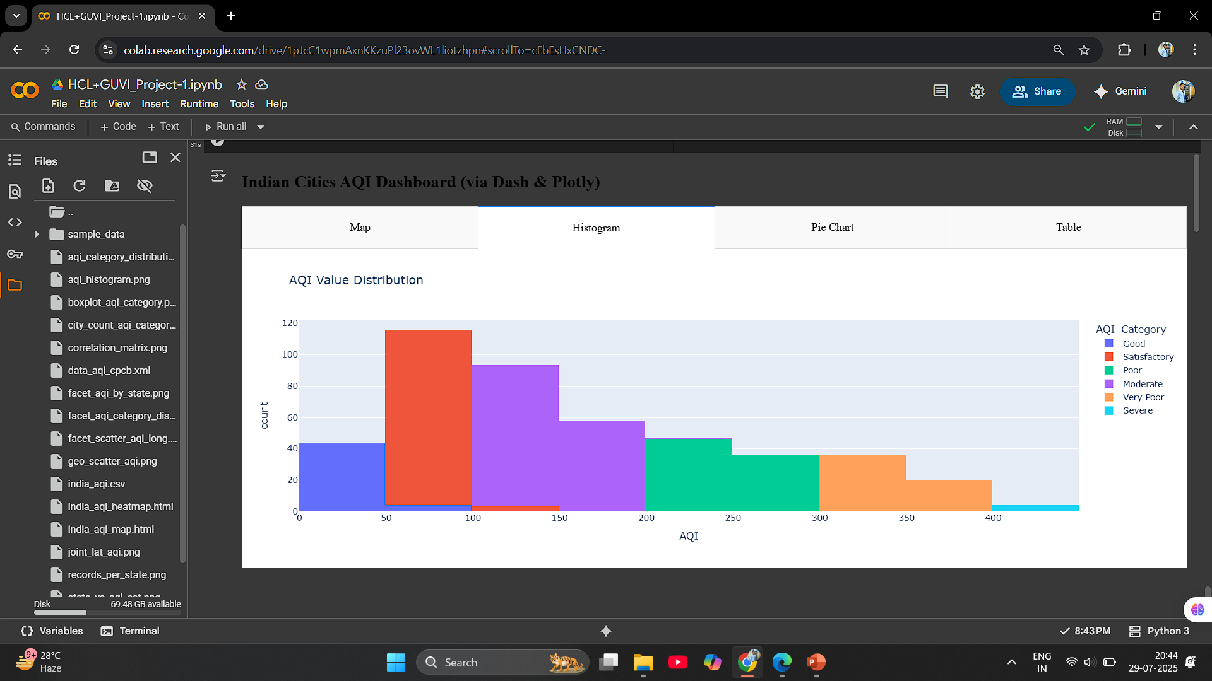
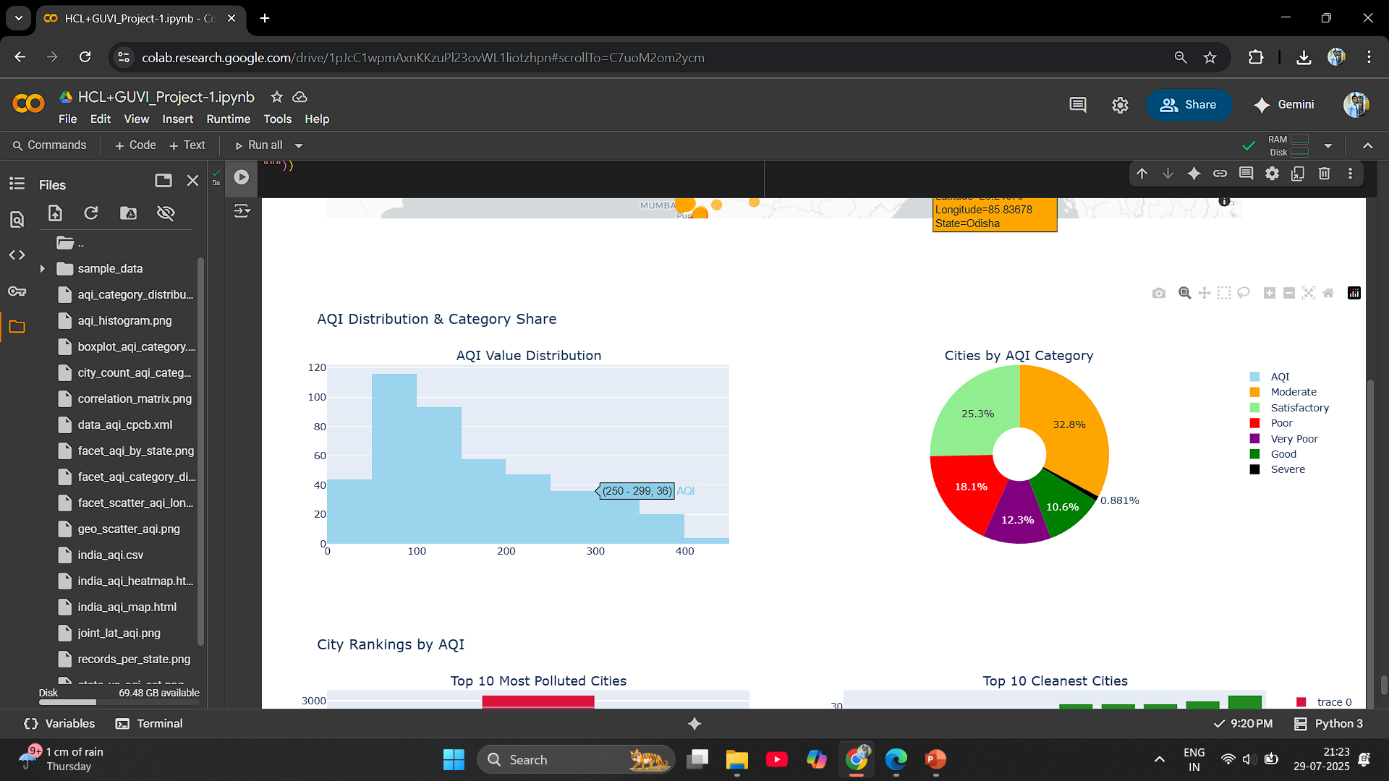
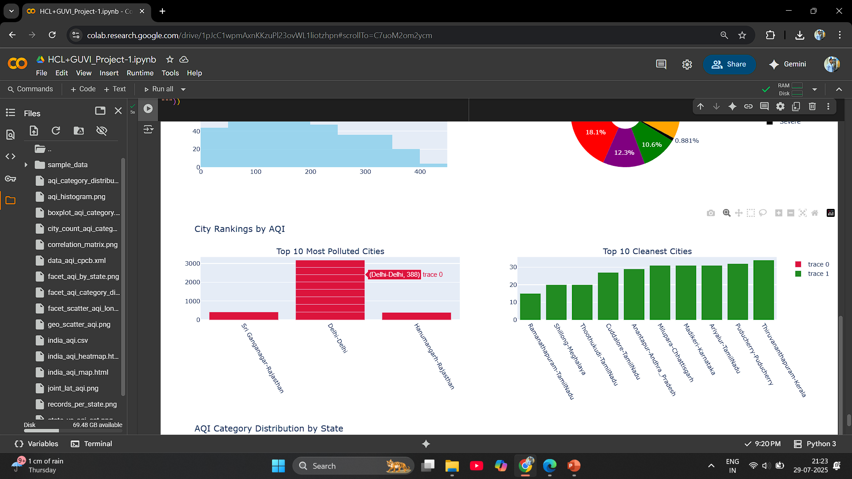
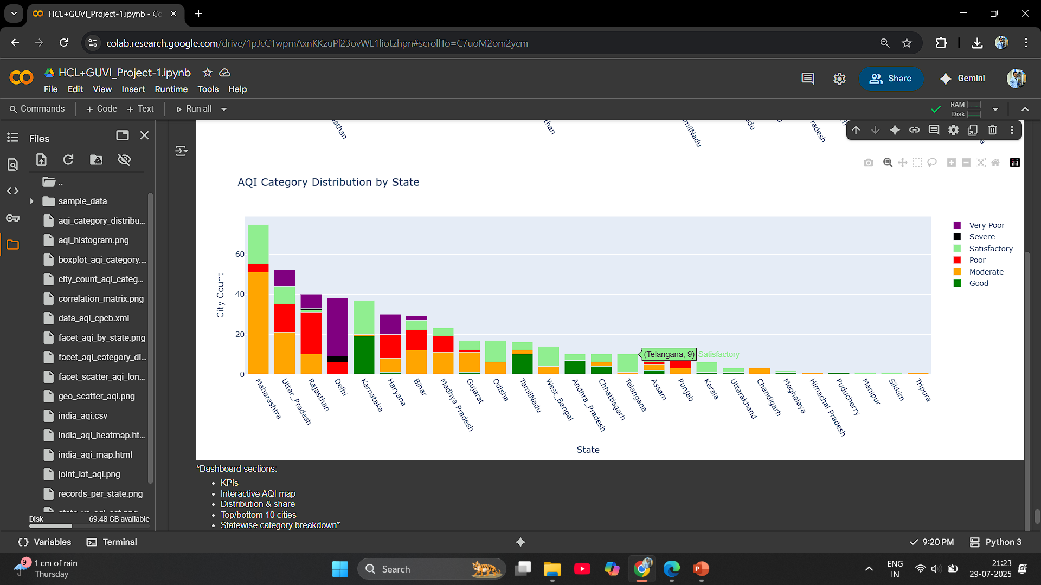

Slide 10
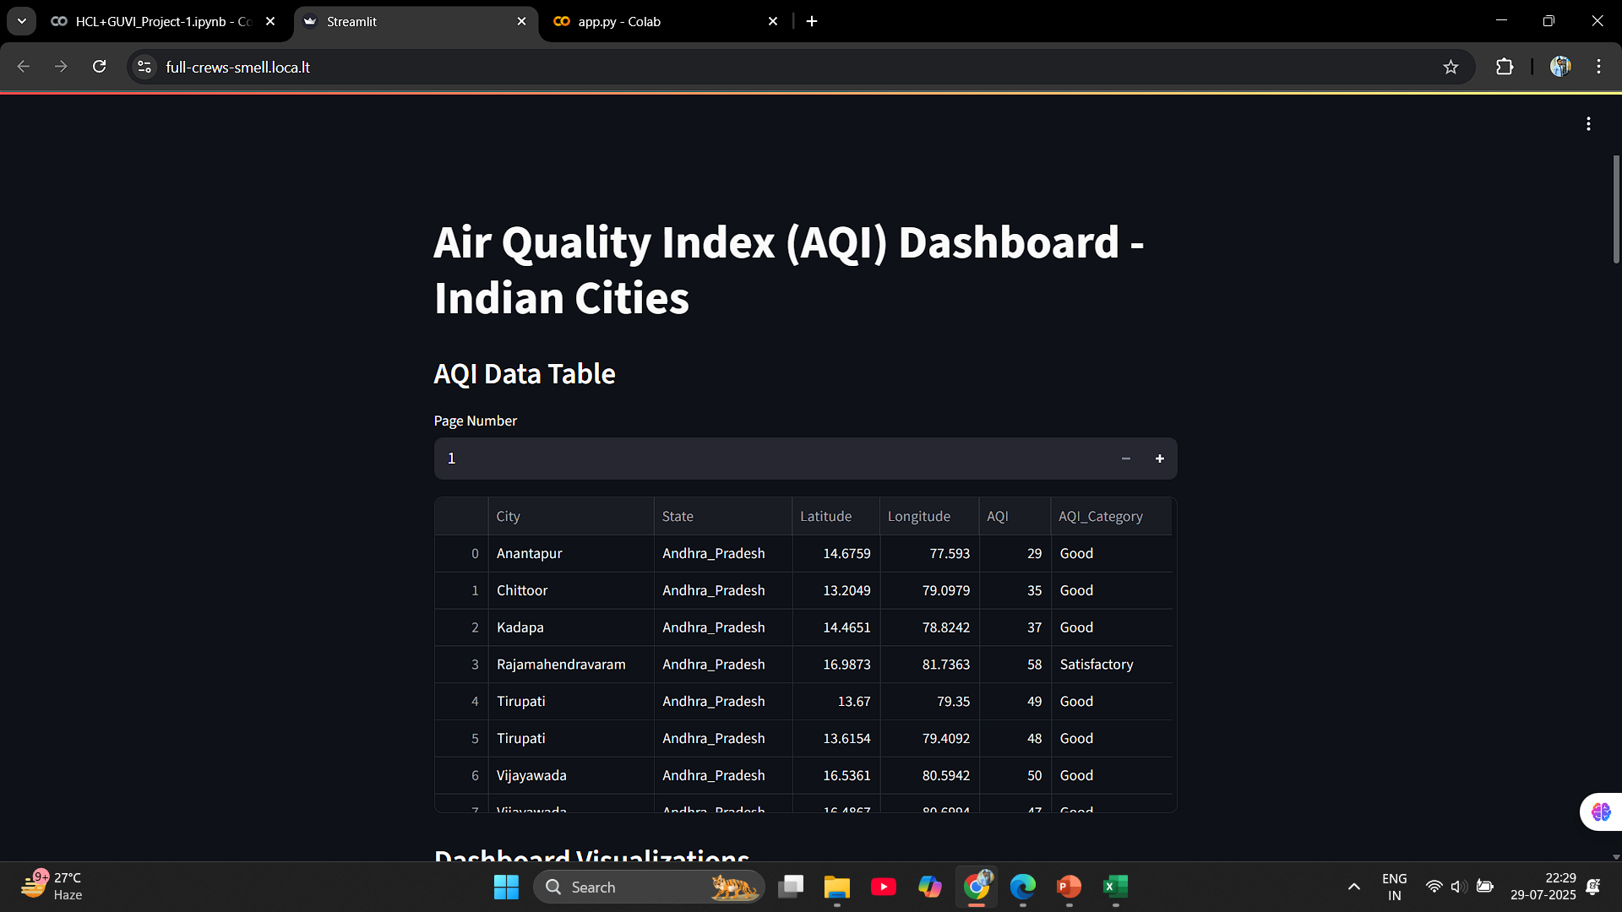

Slide 11
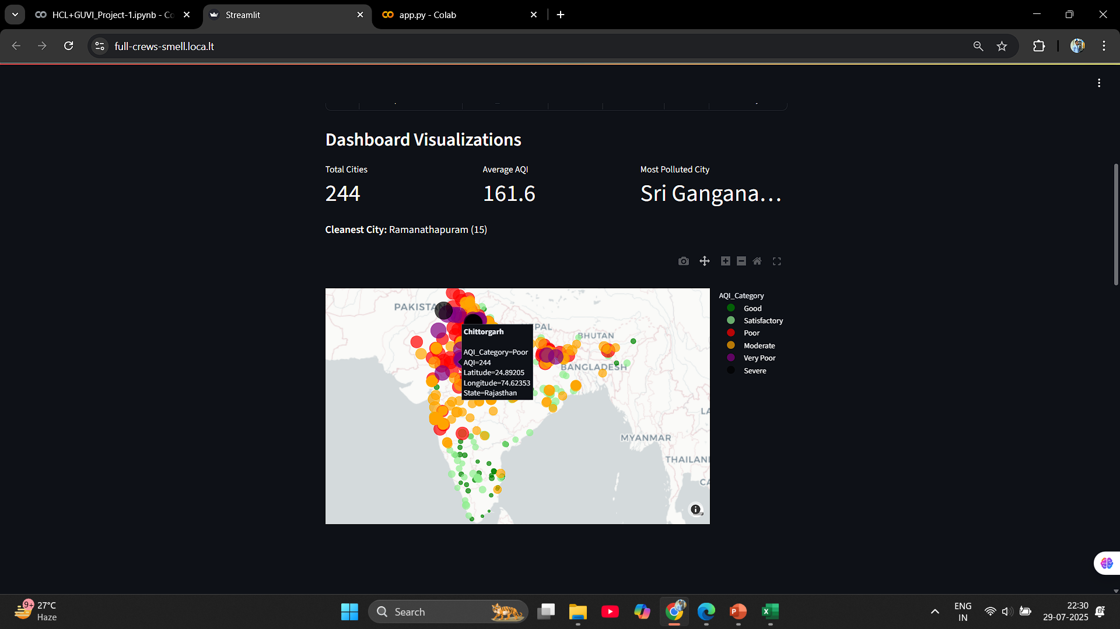

Slide 12
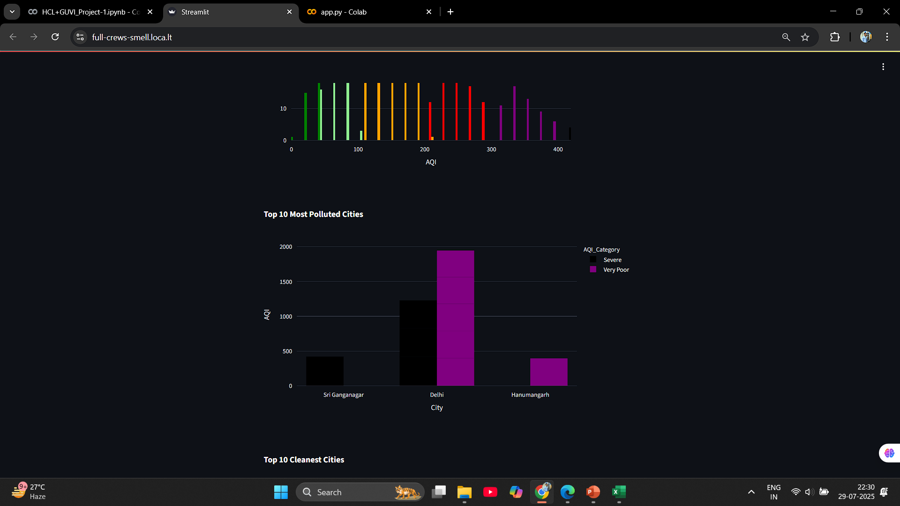

Slide 13
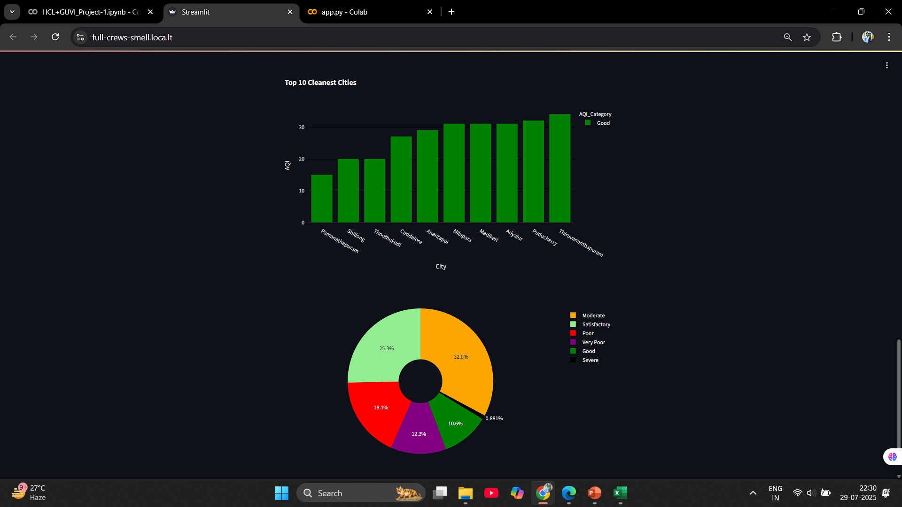

Slide 14
Thank You…

